Slide 1
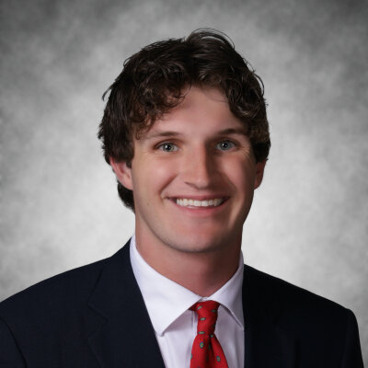
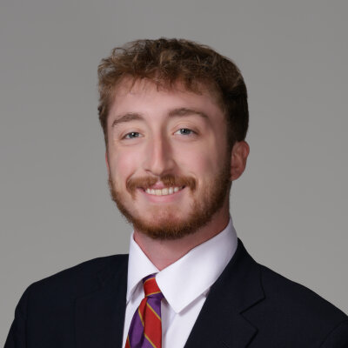
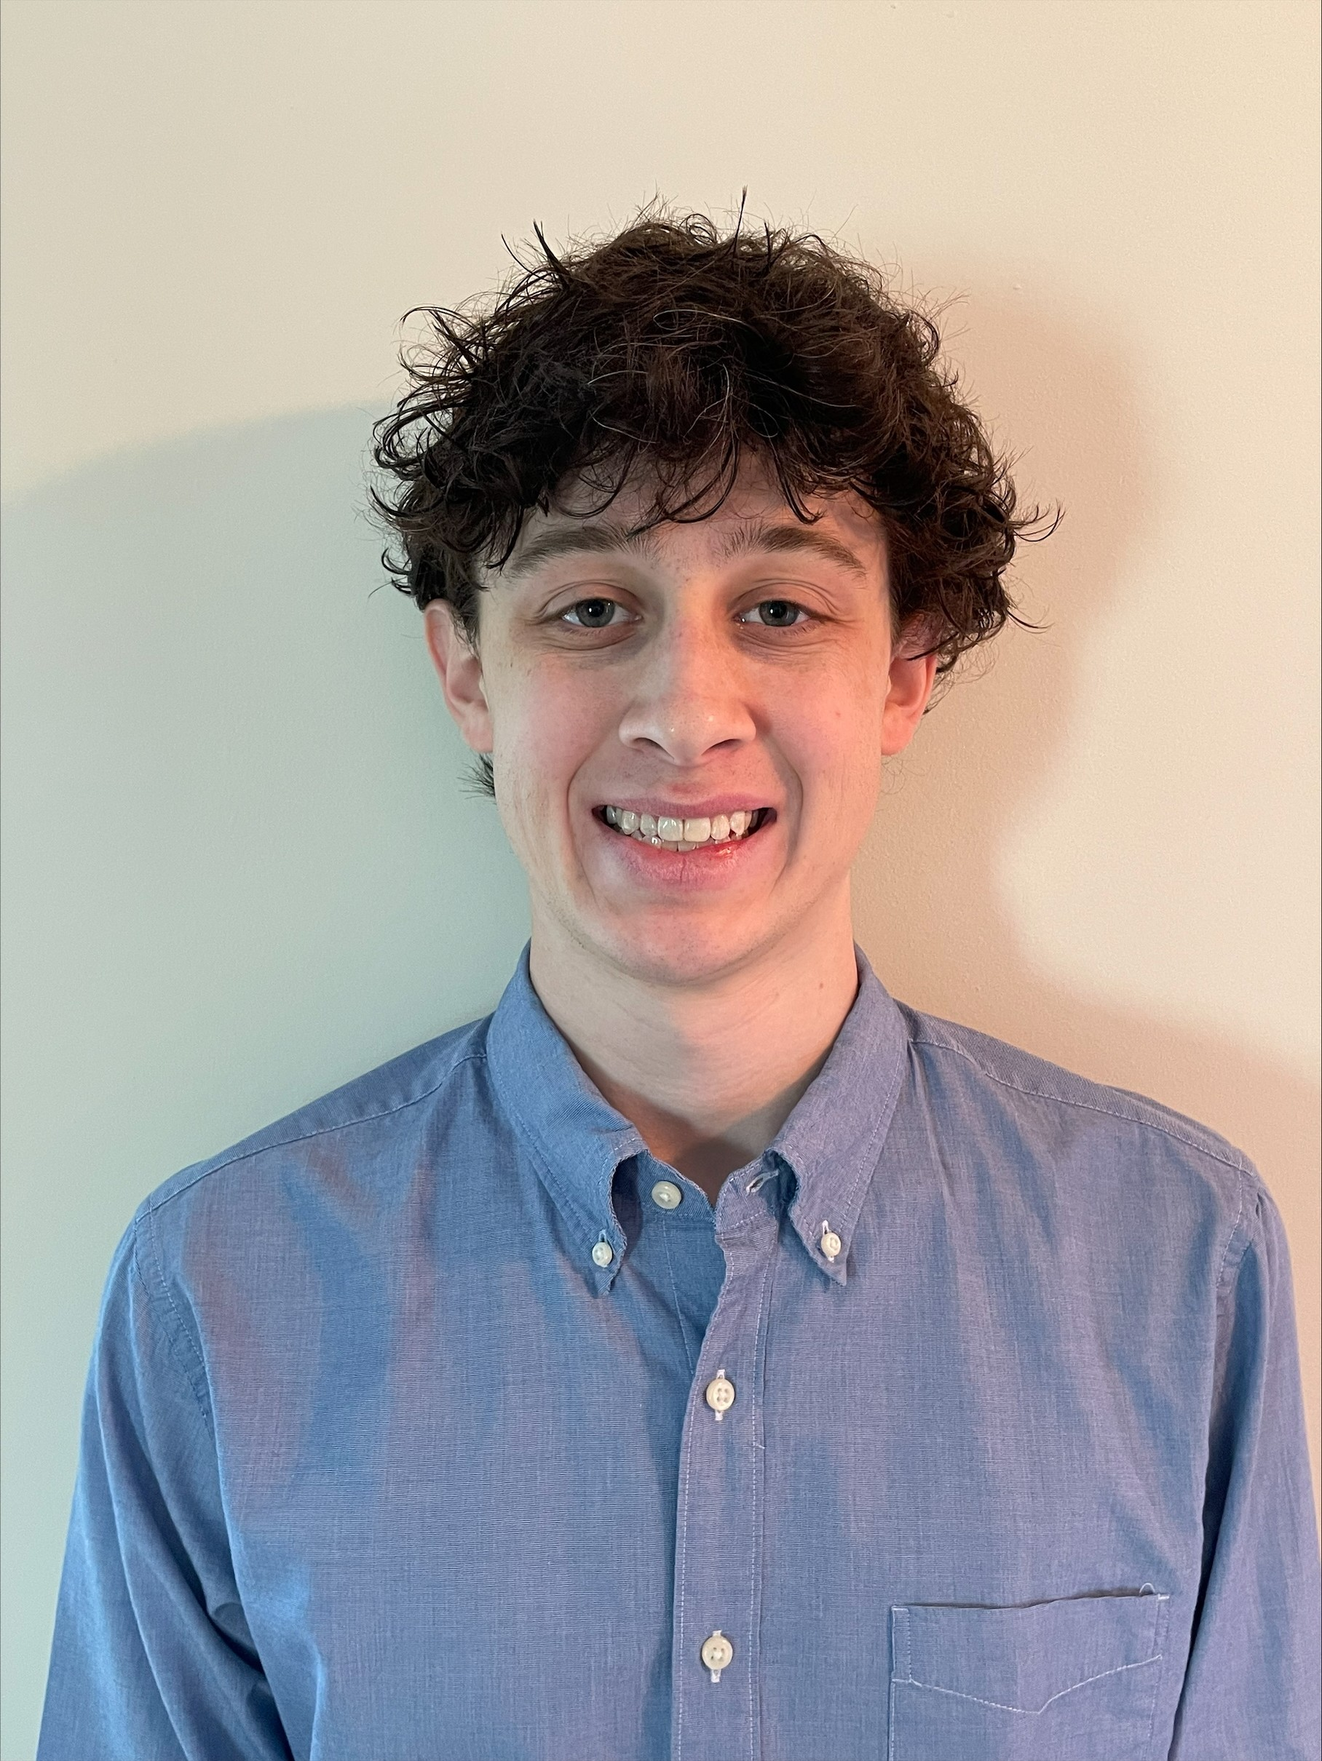

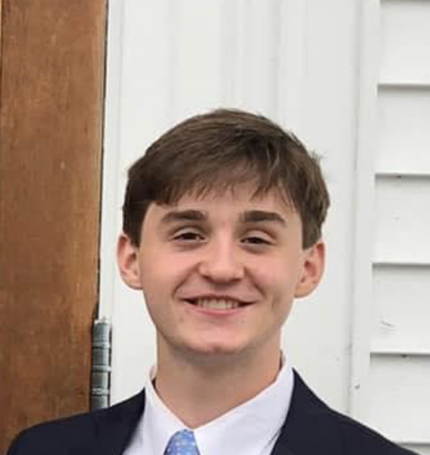
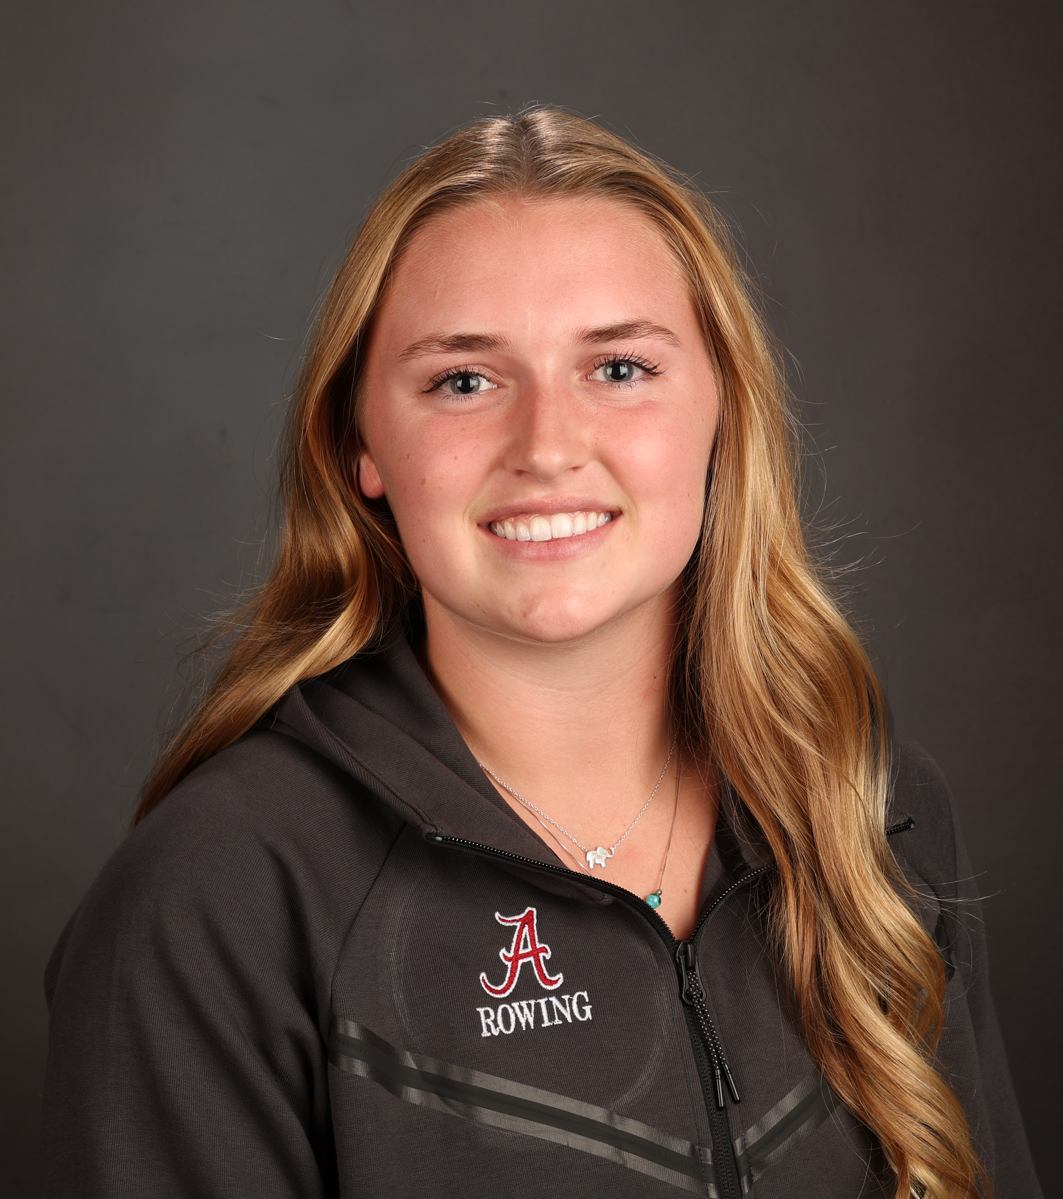
SmartGlass Analytics – Sprint 2 …
Project Website
Gabe Gros
Chris Hellen
Ethan Schwalbach
github repo
Aiden Carroll
Kendall Hamm

Slide 2
Project Focus
Build third party app on host tablet to keep up with stats from provided API
Enable user of tablet to display whatever stats they prefer to see at that time

Slide 3

Sprint Goals
Expand and Improve User Interface
Give a more comprehensive view of selectable players and data
Establish a baseline with the Synergy API
Begin work with pulling live stats, set foundation for more expanded later functionality

Slide 4
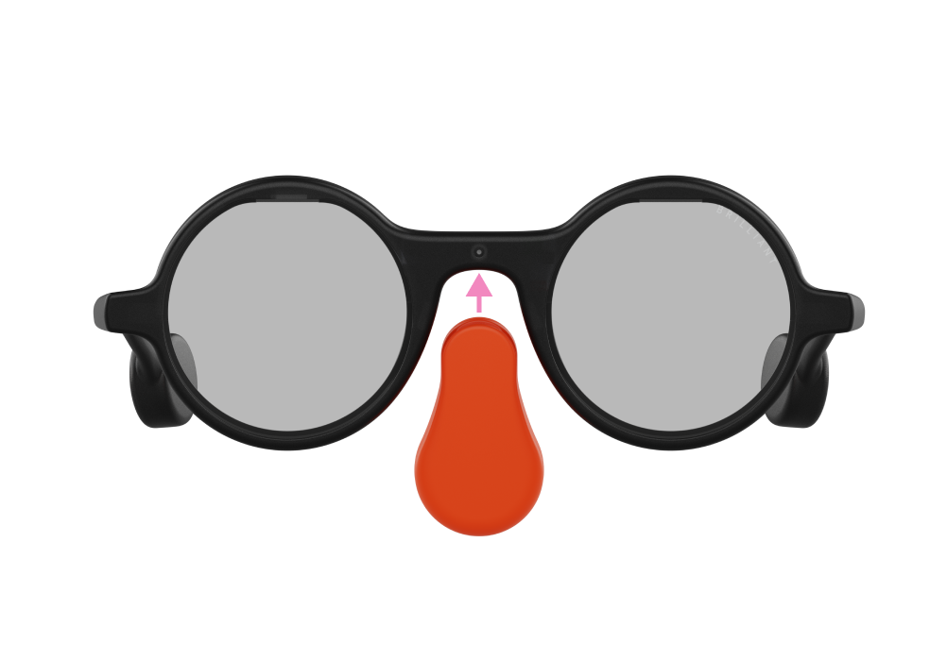
Major Sprint Achievements/Feedback from Sponsor
Major Achievements
Upgraded Android app UI
Deployed Android app to ELO tablet
Ran Python code in Android Studio
Connected to glasses using frameutil Python package
Feedback from Sponsor
Sponsor was satisfied with our progress in Sprint 1
Received ELO tablets and Synergy access from sponsor
Have not met with sponsor to go over Sprint 2 results yet due to SEC championship, March Madness, etc

Slide 5
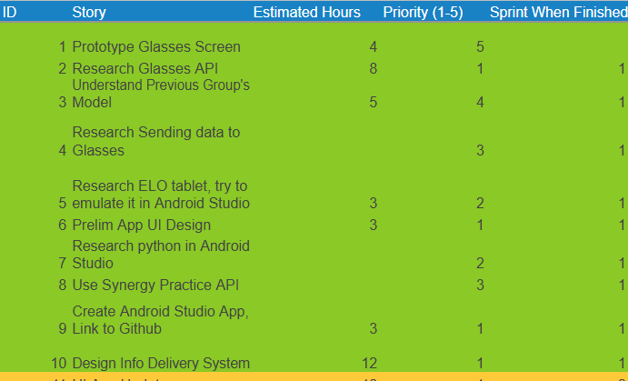
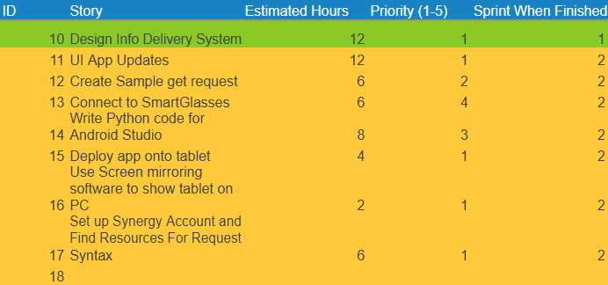
Project & Sprint Backlog
Sprint 1
Sprint 2

Slide 6
Sprint Contributions
Aiden Carroll
Gabe Gros
Chris Hellen
Work on UI changes, deploy app on tablet, mirror tablet screen on laptop, make get request to server
Research method and Connect to Glasses using frameutils package
Research how to and run python code in Android Studio
Ethan Schwalbach
Kendall Hamm
Create Synergy account, researching encrypting methods for API key, attempt a get request
Implemented new UI screens/updates, Player data, App navigation

Slide 7
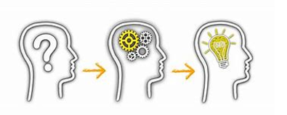
What was not completed/Lessons Learned
Not Completed
Successful API calls not yet made, working with Synergy support team while they resolve internal issue prohibiting successful API calls being made
Integration of separate efforts into the app, current development still partially siloed
Cybersecurity concerns not fully implemented, issues addressed but not solved in code yet
Lessons Learned
Don't take working tech for granted
Merge often, merge early
Keep each other up to date on current development

Slide 8
Live Demo

